Slide 1
Growth And Characterization Of Ferroelectric Thin Films Using PLD

Slide 2
CONTENTS
1. Material Systems and Device Structure
2. Introduction to Pulsed Laser Deposition Technique
3. Growth of Ferroelectric Pb(Zr₀.₂Ti.)O Thin Films And Structural Characterization
4. Calculation of PZT Average Lattice Parameters from X-Ray Diffraction Techniques
5. Effects of Epitaxial Strain on PZT c-domain Structural Parameters And Measurement of the Spontaneous Polarization
6. Dielectric Characterization And Frequency Dispersion Effects of Epitaxial Strain on PZT Spontaneous Polarization
7. Strain Relaxed PZT Films grown on STO Substrates
8. Voltage Controlled Ferroelastic Switching in Polydomain PZT Films grown on buffered GSO substrates

Slide 3
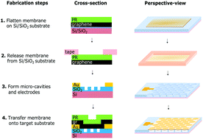
1. Material Systems and Device Structure

Slide 4
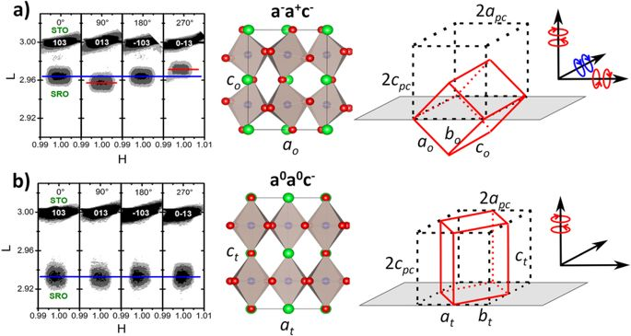

Slide 5
2. Introduction to Pulsed Laser Deposition Technique
To explore the phase space of the negative capacitance phenomenon with respect to the structural and electrical
characteristics, the properties of the PZT films were epitaxially strain tuned by depositiig films on three different
substrates, namely SrTiO(STO), DyScO(DSO) and GdScO(GSO).

Slide 6
3. Growth of Ferroelectric Pb(Zr₀.₂Ti.)O Thin Films And Structural Characterization
Figure 1 shows the X-ray diffraction (XRD) 2θ​- θ​ scans of the SRO films around the (002) reflection of the STO substrate before and after progressively changing the He doses. The undosed SRO film is epitaxial to the sub-strate with high structural quality as revealed by the clear Laue fringes.
The pseudocubic out-of-plane latticeparameter of the undosed film is c pc =​ 3.952 Å. This value is larger than the bulk pseudo-cubic lattice parameter of c pc,bulk =​ 3.928 Å 29,30 due to the Poisson effect as the film is under compressive strain on STO (a STO =​ 3.905 Å).
The coherent growth on STO is expected from many previous studies on the growth of SRO films 17,23,25 . It is worth noting that the measured out-of-plane lattice parameter of 3.952 Å is exactly what is expected of a stoichiometric SRO film fully epitaxially strained on an STO substrate given SRO’s known Poisson ratio of SRO (ʋ​ =​ 0.33) 31 . By introducing progressively higher doses of He into the SRO lattice, we observe that the 002 peak shifts to lower angles.
This result indicates that the average out-of-plane lattice parameter is expanded. The out-of-plane expansion from the as-grown state is shown as 0.33% for the 0.8 × ​ 10 15 He/cm 2 low dose, 1.14% for the 2.5 × ​ 10 15 He/cm2 moderate dose, and 1.75% for the 5 ×​ 10 15 He/cm2 high dose. We observe that there is a slight peak broadening that accompanies an increase in He dose, which is expected due to the inherent Gaussian distribution of He in the lattice after implantation. The cap layer method described above is sufficient to greatly reduce these effects so that uniformity is still very good as evidenced by the Laue fringes and their uniform shift with the film peaks.
From these data, we can clearly see that the introduction of He into the film allows control over the length of the out-of-plane parameter.

Slide 7
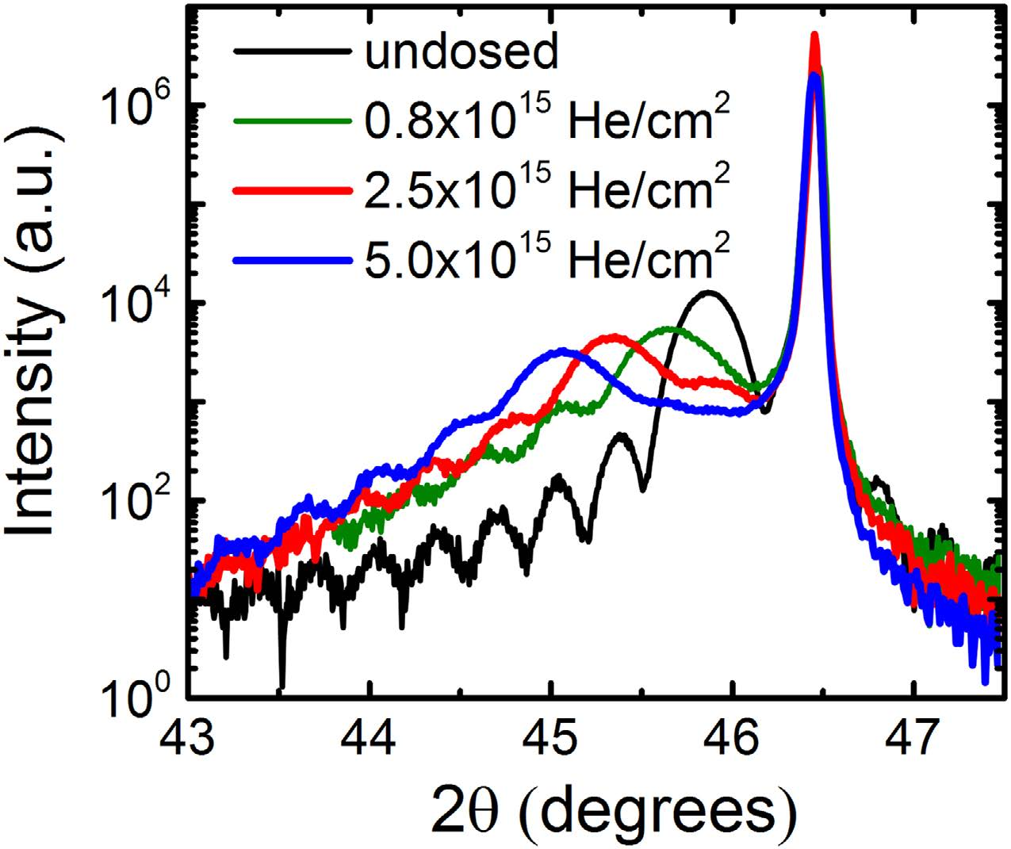

Slide 8
4. Calculation of PZT Average Lattice Parameters from X-Ray Diffraction Techniques

Slide 9
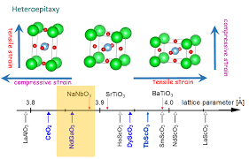
5. Effects of Epitaxial Strain on PZT c-domain Structural Parameters And Measurement of the Spontaneous Polarization

Slide 10
6. Dielectric Characterization And Frequency Dispersion Effects of Epitaxial Strain on PZT Spontaneous Polarization

Slide 11
7. Strain Relaxed PZT Films grown on STO Substrates

Slide 12
8. Voltage Controlled Ferroelastic Switching in Polydomain PZT Films grown on buffered GSO substrates

